Slide 1
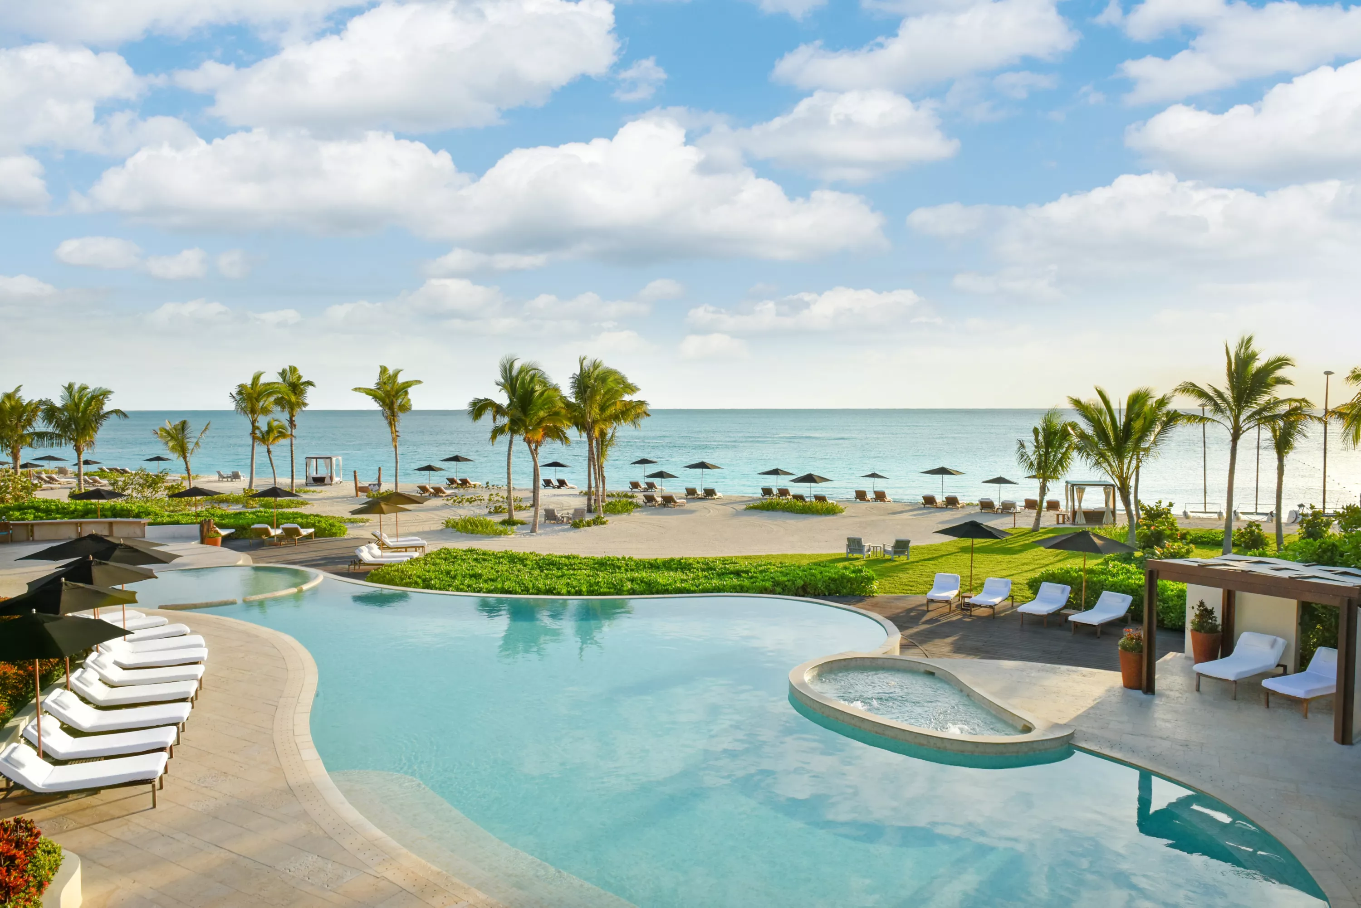
PROJECT STATMENT
analyze hotel reservation data to gain insights into the reasons behind reservation cancellations and to identify which specific days are economically beneficial for the hotel. The analysis aims to help the hotel management optimize their operations, improve customer satisfaction, and increase revenue.
Github code-data-analysis-project/Hotel reservation and economic analysis.ipynb at main · chirag2412/data-analysis-project (github.com))

Slide 2
Objective
Understand Cancellation Reasons: Identify and analyze the main factors contributing to reservation cancellations.
Economic Analysis of Days: Determine which days of the week or specific dates are most profitable for the hotel.
Customer Behavior Insights: Gain insights into customer booking patterns and preferences.

Slide 3
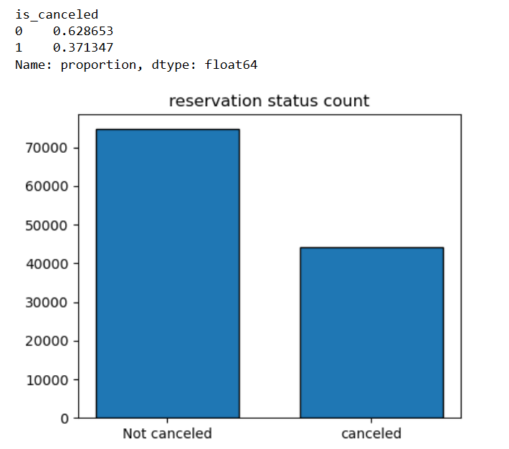
Reservation status data
The bar chart clearly indicates that the number of reservations that were not canceled is significantly higher compared to those that were canceled. This highlights a positive trend where the majority of customers follow through with their reservations. However, despite the lower number of cancellations, it remains essential to delve deeper into understanding the underlying reasons for these cancellations.
By examining the factors contributing to reservation cancellations, we can identify patterns and potential areas for improvement. This deeper analysis will allow us to develop targeted strategies to minimize cancellations, enhance customer satisfaction, and optimize operational efficiency. Addressing the root causes of cancellations can lead to increased occupancy rates and higher revenue, further strengthening the hotel's market position.
.

Slide 4
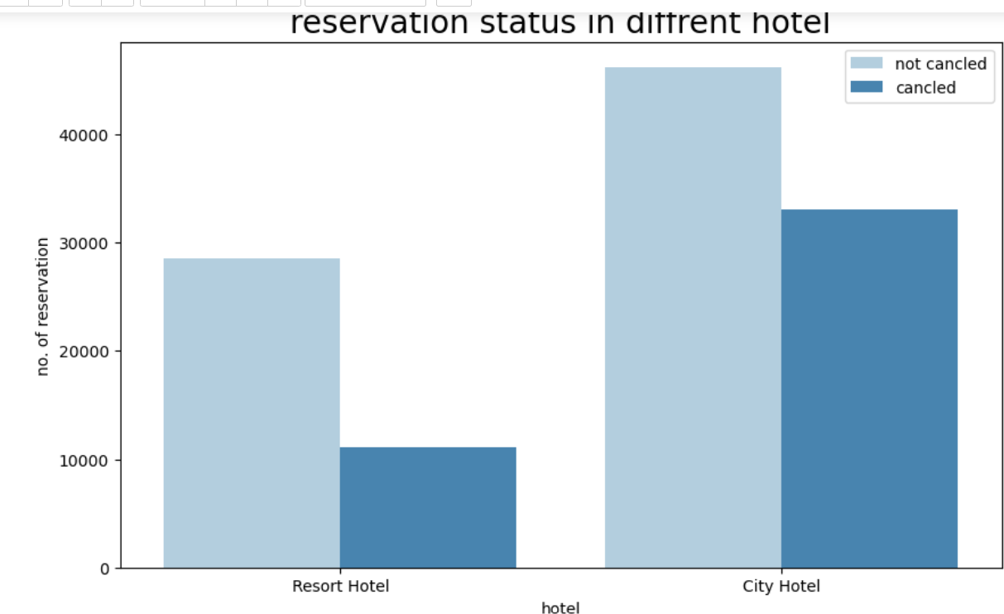
Reservation status for city and resort hotel
To gain a comprehensive understanding of reservation patterns, we analyzed the cancellation status data for both resort and city hotels. A bar chart was created to visualize the number of canceled and non-canceled reservations for each hotel type.
The bar chart reveals several key insights:
Higher Non-Cancellation Rates: Both resort and city hotels show a significantly higher number of non-canceled reservations compared to canceled ones. This indicates a strong customer commitment to their bookings in both hotel types.
Comparative Analysis:
Resort Hotels: Exhibit a lower number of canceled reservations, suggesting a higher likelihood of guests following through with their stays. This could be attributed to the unique value proposition and amenities offered by resort hotels, which might lead to stronger customer intent and fewer cancellations.
City Hotels: While still maintaining a higher number of non-canceled reservations, city hotels experience a greater number of cancellations compared to resort hotels. This might be influenced by factors such as the nature of travel plans in urban settings, which can be more susceptible to changes.

Slide 5
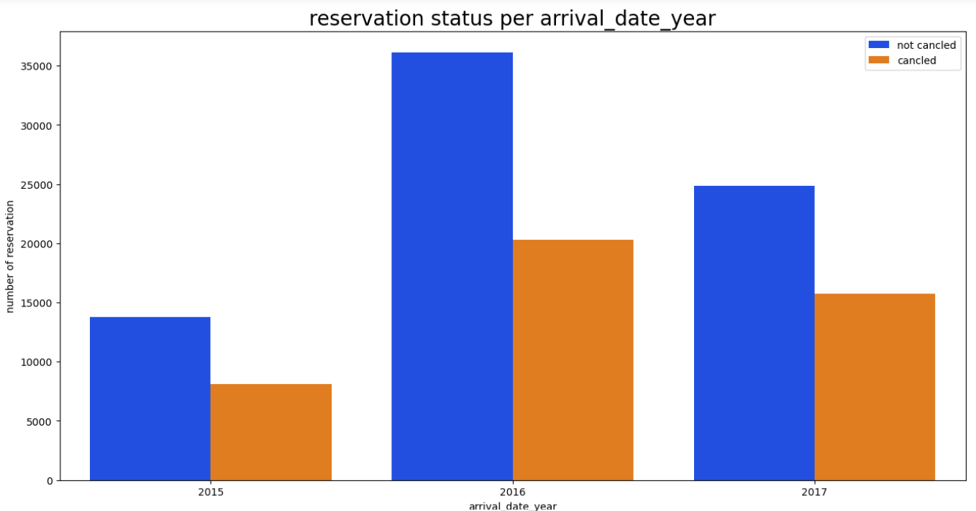
Reservation status based on year
The increase in reservations in 2015 suggests that certain factors during that year, such as marketing campaigns, special events, or economic conditions, may have positively influenced booking activity. Understanding these factors could help in replicating such success in future years. Additionally, the stable cancellation rates across the years indicate consistent customer behavior regarding cancellations.
.

Slide 6
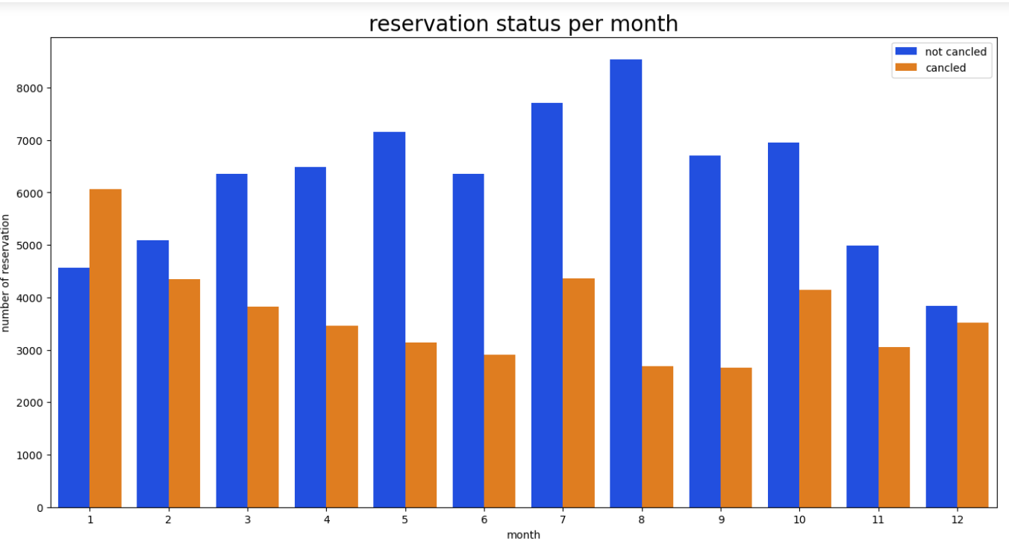
Reservation status per month
Peak Reservation Period:
may to August: The data indicates that the highest number of reservations occur between June and August. This period likely corresponds with peak travel seasons, such as summer vacations and holidays, where the demand for hotel stays is at its highest.
Lower Cancellation Rates: During these peak months, the cancellation rates are notably lower compared to other months. This suggests that guests are more committed to their bookings during these months, possibly due to pre-planned vacations and favorable travel conditions.
Lower Reservation Periods:
January to febuary and november to December: The first three and last three months of the year show lower reservation volumes. This could be attributed to factors such as post-holiday lulls, colder weather in many regions, and fewer travel plans.
Higher Cancellation Rates: During these lower booking periods, the cancellation rates are relatively higher. This may be due to more flexible travel plans or changing circumstances that lead to cancellations
.

Slide 7
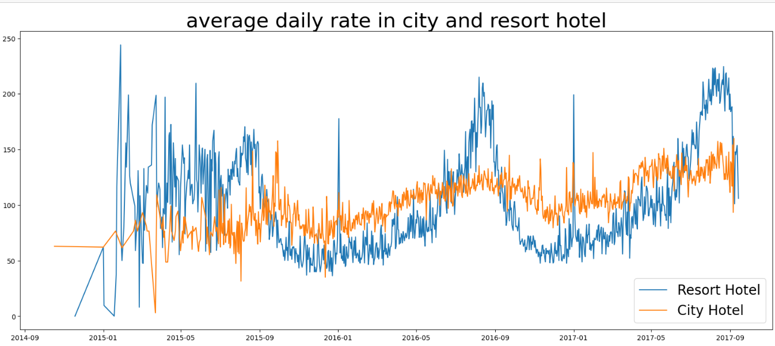
Average daily rate based on date with respect to hotel
Quarter 1 (Q1) Analysis:
Resort and City Hotels: During the first quarter of the year (January to april), both resort and city hotels exhibit lower ADRs, ranging between 50 to 100. This indicates a more competitive pricing strategy, possibly to attract guests during the slower travel season.
Quarter 2 (Q2) Analysis:
Resort Hotels: In the second quarter (may to June), resort hotels show a significant increase in ADR, ranging between 130 to 200. This rise can be attributed to the beginning of the peak travel season, including spring and early summer vacations, where demand for resort stays typically increases.
.City Hotels: Similarly, city hotels also experience an increase in ADR during the second quarter, with rates ranging between 50 to 140. This may be due to increased business travel and tourism during this period.

Slide 8
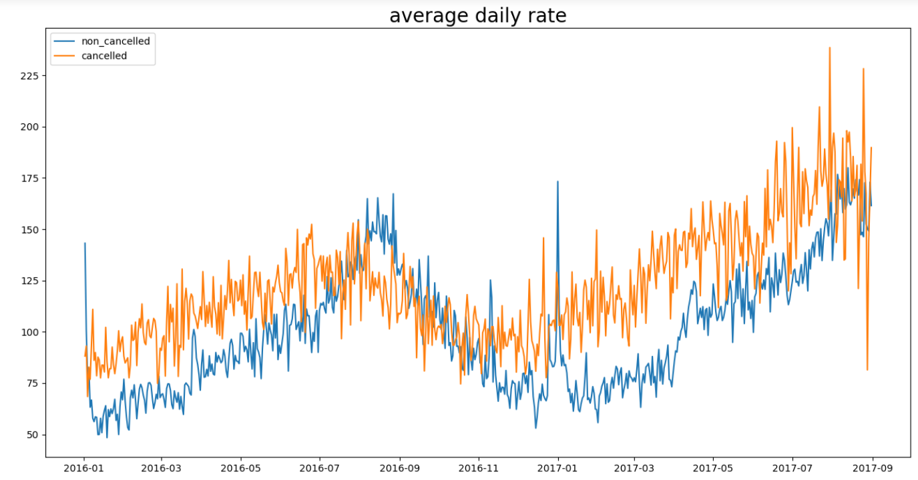
Adr with respect to date based on date
Quarter 1 (Q1) Analysis:
2016 and 2017: For both canceled and non-canceled reservations, the ADR in the first quarter is significantly lower compared to other quarters. This trend is consistent across both years, indicating a strategy of lower pricing to attract bookings during the slower travel season.
Quarter 2 (Q2) and Quarter 3 (Q3) Analysis:
Higher ADR: In the second (April to June) and third (July to September) quarters, the ADR is substantially higher for both canceled and non-canceled reservations. This suggests a peak travel season where demand is high, allowing for higher pricing.

Slide 9
Conclusion
There is a significant increase in ADR for both resort and city hotels during the second and third quarters. This corresponds with higher demand and lower cancellation rates, likely due to favorable travel conditions and holiday periods
The ADR is significantly lower in the first quarter, which is consistent for both canceled and non-canceled reservations. This suggests a pricing strategy aimed at attracting bookings during a traditionally slower travel season.
Higher Non-Cancellation Rates: Both resort and city hotels have significantly higher numbers of non-canceled reservations compared to canceled ones.
Peak Reservation Periods: The highest number of reservations occurs from June to August, with lower cancellation rates during these months.
Lower Reservation Periods: The first three and last three months of the year show lower reservation volumes and higher cancellation rates.

